Slide 1
A Comparative Study: Sensor Fusion of LiDAR and RADAR using Kalman Filter and Extended Kalman Filter
Seminar Electromobility SS 2020
Ainapurapu, Sayed, Shenoy
Electromobility Research Group
University of Kaiserslautern

Slide 2
Contents
Introduction
Sensors for ADAS
Parameters for Sensor Selection
LiDAR Selection
RADAR Selection
Kalman Filter
Functioning
Understanding
Working
Comparison
Kalman Filter and Extended Kalman Filter
Conclusion and Future Scope

Slide 3
Introduction
What are Advanced Driver Assistance Systems (ADAS)?
Advanced driver-assistance systems (ADAS) are electronic systems that assist drivers in driving and parking functions. Through a safe human-machine interface, ADAS increase car and road safety.
Necessity of Advanced Driver Assistance Systems (ADAS)
Prevent accidents: Make vehicles smart enough to predict accident in beforehand and take necessary action.
Increases the driver and passenger safety
Enhance the driver comfort and better driving experience
Enhance the traffic and road awareness
Enhance the fuel consumption
Applications of ADAS
Electronic stability control (ESC), anti-lock braking systems (ABS), and lane keeping assistant (LKA).

Slide 4
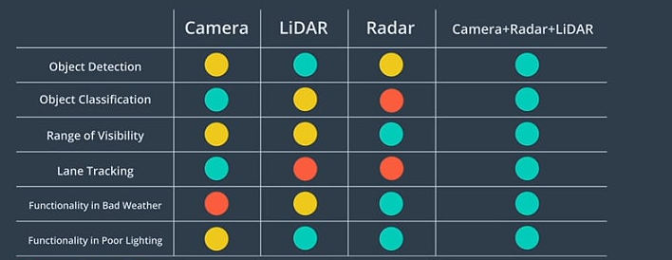
Sensors for ADAS
Sensors in ADAS: Lidar, Radar, Vision sensors: IR Camera, Mono Camera, Stereo Camera, and ultrasonic sensor
Why sensor fusion?
Poor
Mixed
Good
Fig. 1: Performance Comparison of Camera, Lidar and Radar for various parameters [1]

Slide 5
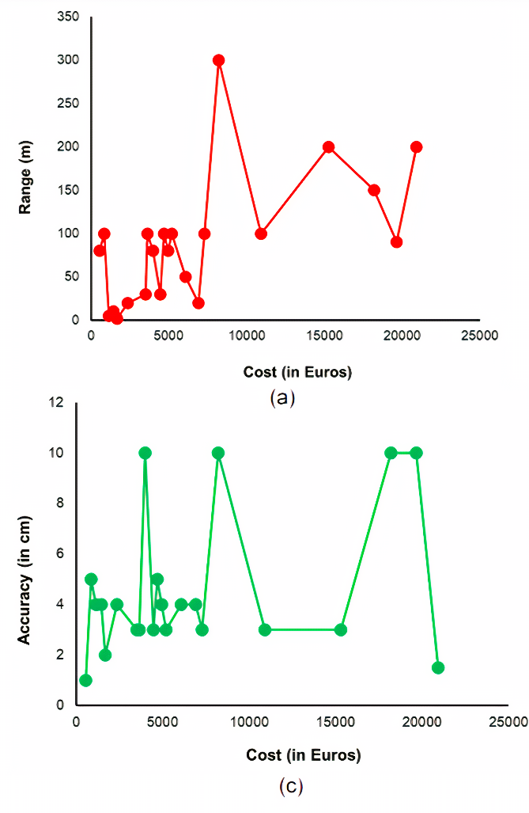
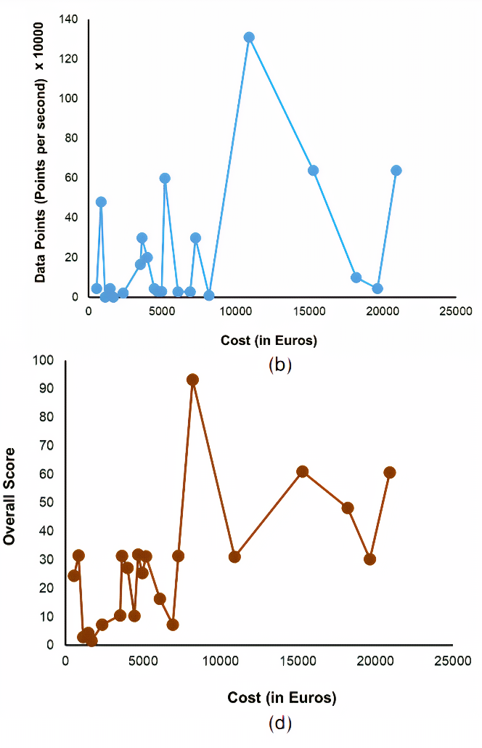
Parameters for LiDAR Selection
LiDAR Selection
Cost based variation
Range: Trade-off between maximizing the probability of pulse detection vs minimizing the false positive probability. Reflected in the cost vs range plot for different LiDAR’s.
Points per second: Accounting for higher processing requirement with the increase in the number of data points.
Accuracy: Ability to maintain tight beam diameter over long ranges has an impact on the cost.
Overall Score: weighted assessment of different LiDAR‘s based on the parameters.
Fig. 2: Cost based comparison of LiDARs a) Range b) Points per second c) Accuracy and d) Overall Score.

Slide 6
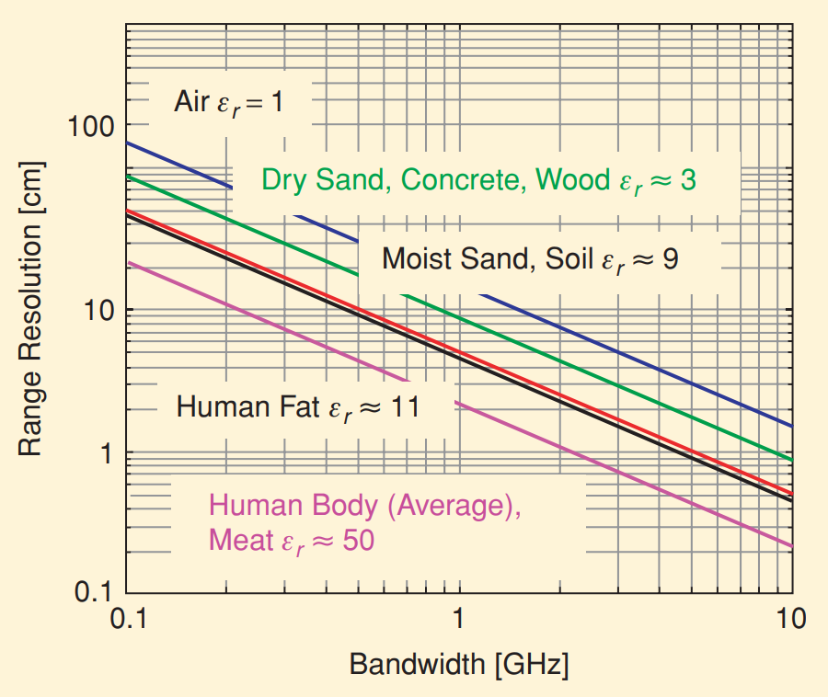
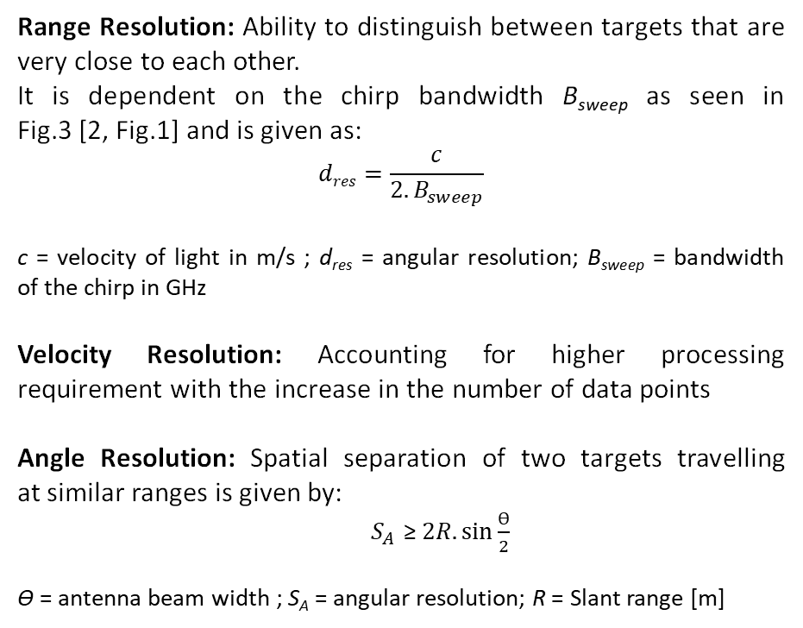
Parameters for RADAR Selection
RADAR Selection
Range Resolution: Ability to distinguish between targets that are very close to each other.
It is dependent on the chirp bandwidth B_{sweep} as seen in Fig.3 [2, Fig.1] and is given as:
$$dres=\frac{c}{2.B_{sweep}}$$
c = velocity of light in m/s ; d_{res} = angular resolution; B_{sweep} = bandwidth of the chirp in GHz
Velocity Resolution: Accounting for higher processing requirement with the increase in the number of data points
Angle Resolution: Spatial separation of two targets travelling at similar ranges is given by:
${ S}_{A }$≥ $2R. \sin{\frac{ϴ}{2}}$
ϴ = antenna beam width ; S_{A} = angular resolution; R = Slant range [m]
Fig.3 : Range resolution variation for a short range RADAR [2, Fig.1].

Slide 7
Important Points of Kalman Filter - Optimal (it minimizes mean square error between estimate and real value) - Recursive (will take last set of results as input for next calculation) - Light on memory (only keep data of last immediate state) - Fast (real time system implementation)
Kalman Filter
Kalman Filter is an algorithm that takes all information known about a system to make a best guess about that system’s future state.
Kalman
Extended Kalman
Unscented Kalman
Fig. 4: Mapping And Predictions Using Sensor Fusion [3]

Slide 8
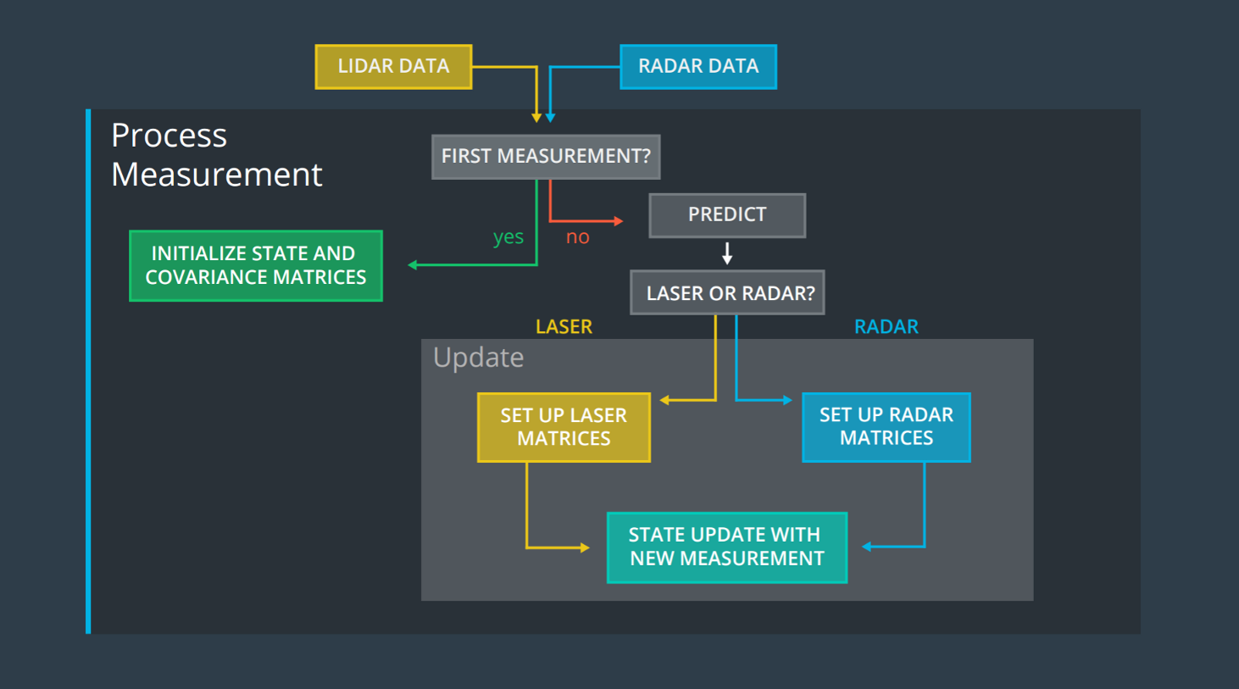
Functioning of Kalman Filter
Fig. 5: Kalman Filter Working Flowchart [4]

Slide 9
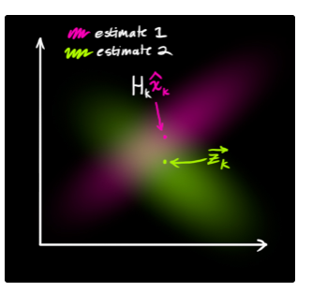
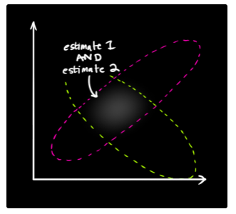
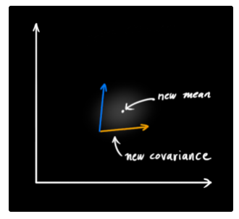
Kalman Filter – Understanding
Estimations From Sensor 1 and 2
Overlapping the sensor data to find Kalman Gain
Finding the New Variance and Mean from the Predictions
Fig. 6: Gaussian Distribution Estimation, Prediction [4]
Notes:
Predict
Correct Prediction (external influence if exists)
Transform Corrected Prediction (speak the same language as our sensors)
Pull in Sensor Reading
Merge Data Sets/Gaussian Distributions
Find Kalman Gain
Update (get new Mean Vector and Covariance Matrix)

Slide 10
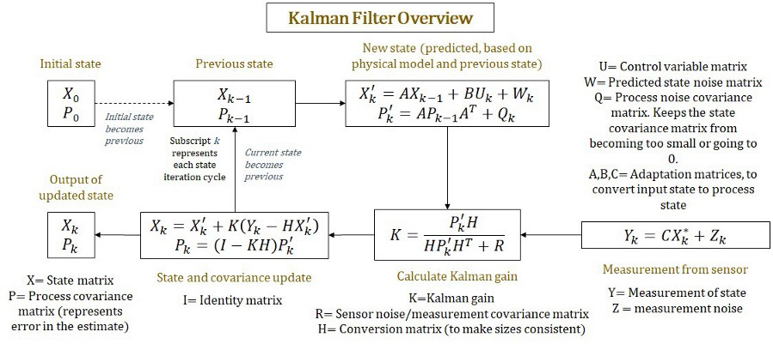
Kalman Filter Working
Fig. 7: Kalman Filter Working Flowchart (Mathematical Explanation) [5]

Slide 11
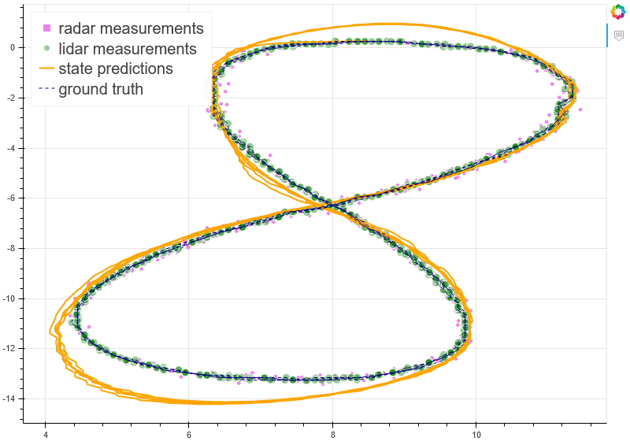
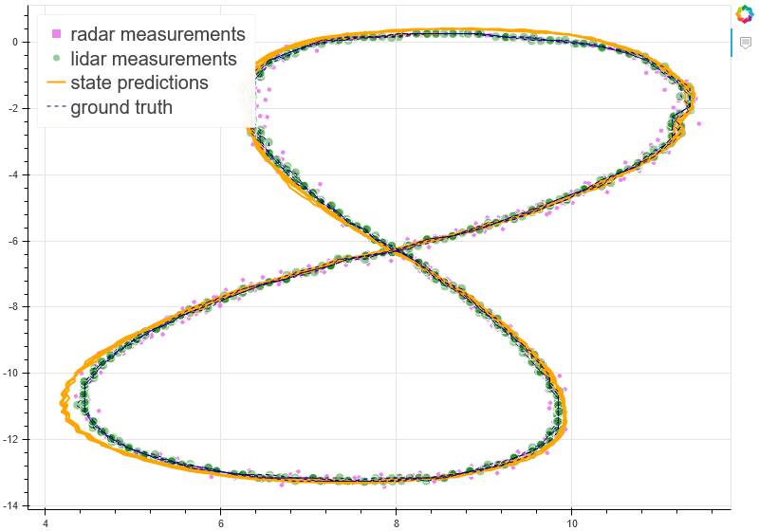
Comparison
Comparing the predictions of Kalman and Extended Kalman Filters with the actual ground truth values
Fig. 8: Application of Kalman Filter on (left) and Extended Kalman Filter (Right) on RADAR and LiDAR

Slide 12
Conclusion and Future Scope
Conclusion:
Extended Kalman filter is the ideal fusion technique when compared to others due to its high accuracy and low computational power requirements.
Application:
These sensors and fusion techniques can be used for application aimed at improving safety and avoiding a crash in all directions.
Future Scope:
Technologies like artificial intelligence and machine learning can be incorporated into these sensor applications of the automobile to enhance driver safety. As the number of users of the vehicle is very large, it is very easy to collect and train the neural network which can take better decisions in crash situations and improve driver safety.

Slide 13
References
[1] Raju, " An intuitive guide to Autonomous Driving Vehicles", Medium 2019.
[2] R. Zetik, J. Sachs, and R. S. Thoma, “Uwb short-range radar sensing the architecture of a baseband, pseudo-noise uwb radar sensor,” IEEE Instrumentation & Measurement Magazine, vol. 10, no. 2, pp. 39–45, 2007.
[3] Mozorov, S., 2020. Ser94mor/Sensor-Fusion. [online] GitHub. Available at: <https://github.com /ser94mor/sensor-fusion> [Accessed 22 May 2019].
[4] Cuevas, M., 2020. Cuevas1208/Sensor-Fusion-With-Kalman-Filters. [online] GitHub. Available at: <https://github.com/cuevas1208/Sensor-Fusion-with-Kalman-Filters/wiki> [Accessed 29 May 2017].
[5] Negi, S., 2018. Overview Of Kalman Filters. [online] Medium. Available at: <https:// medium.com/ @sameer.negi17/overview-of-kalman-filters-95d0ea71d13a> [Accessed 14 June 2018].

Slide 14
Thank You

